Slide 1
Codenvy v4.6.2 (cluster)
Quality Gate
By Andrey Solodov
Skype: andrey.solodov_1
Email: andrey.solodov@aurea.com

Slide 2
Logging in
In order to log in you have to be connected to Aurea VPN (vpn.aurea.com).
Please register yourself in Codenvy, create login/password.
Then please follow the link http://codenvy.aurea.local/f?id=543hw8lmfjx1if3n

Slide 3
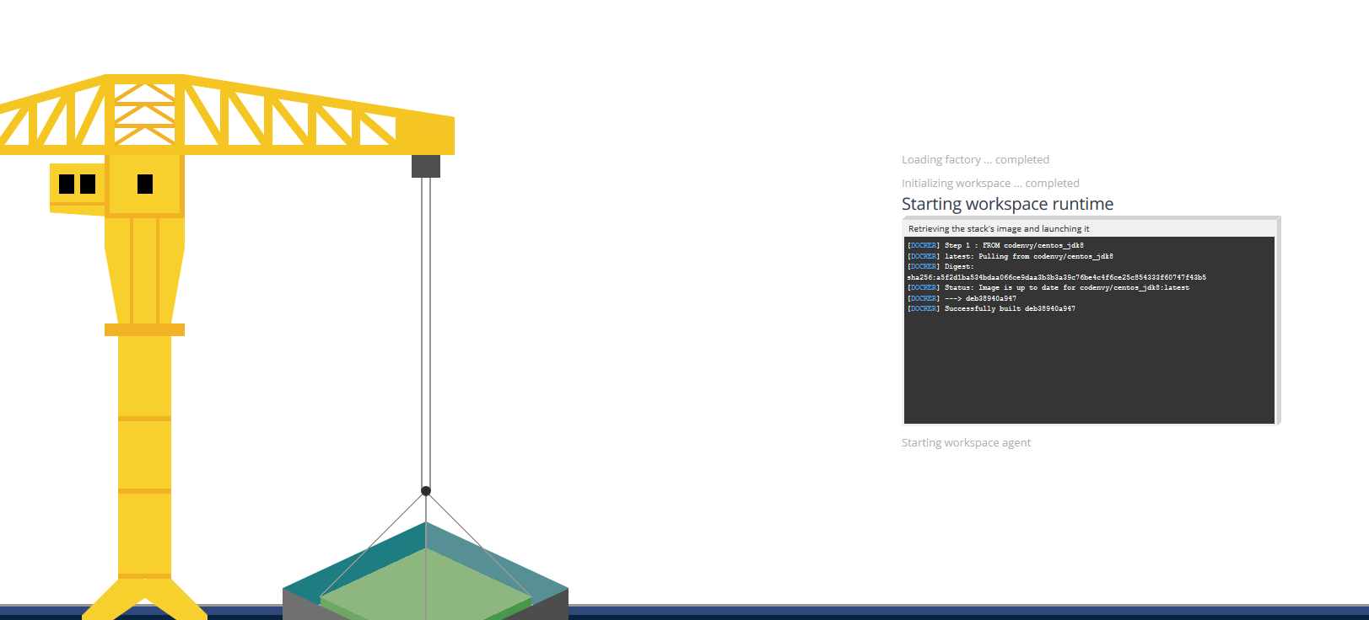
Workspace is creating
When you clicked the link smth interesting has happened. After i configured the project inside Codenvy i created a Factory.
A Factory allowed me to provide you with a link that will create the exact copy of my configured QualityGate workspace. Workspace is a main concept in Codenvy, in the high level it’s a thing that contains source code, runtime and can contain many different machines required for building/running the product. On the lower level workspace is a running Docker container with some default services required for Codenvy itself (like Apache TomCat) and services specific to the project (like ant/maven for building the code)

Slide 4
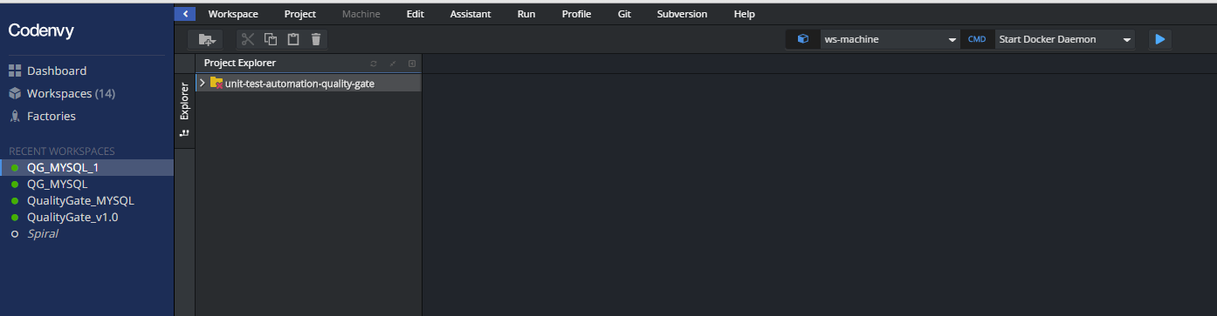
Checking out codebase
The next thing you should do after the workspace is created is to create SSH key-pair and add public key to your Stash account.
This red cross icon shows you that the code for QualityGate was not checked out yet. Let’s create a key pair.

Slide 5
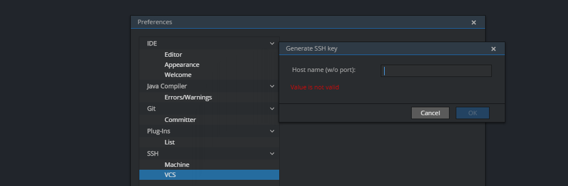

SSH Keys
You need to go to Profile->Preferences->VCS->Generate key
In the hostname type scm.devfactory.com and click OK. You have your key added.
Click on View, copy the key

Slide 6
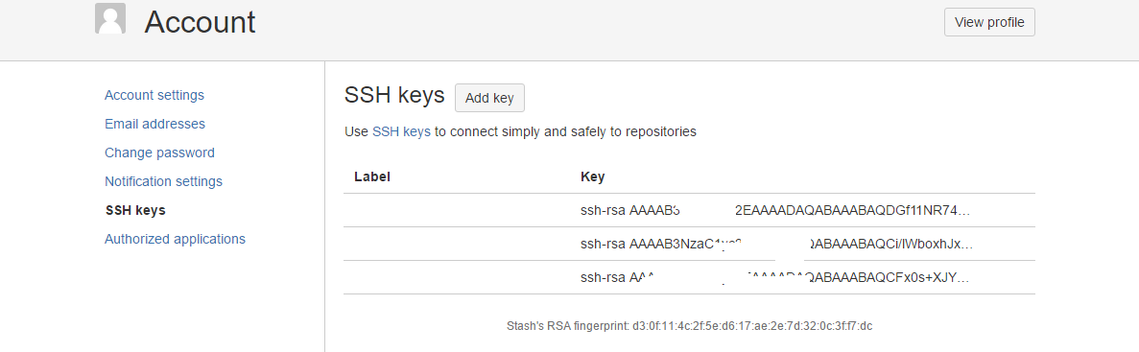
SSH Keys (continue)
Add the key into you Stash account. Please make sure that you have not pasted the key at Bitbucket with the whitespace at the end.

Slide 7
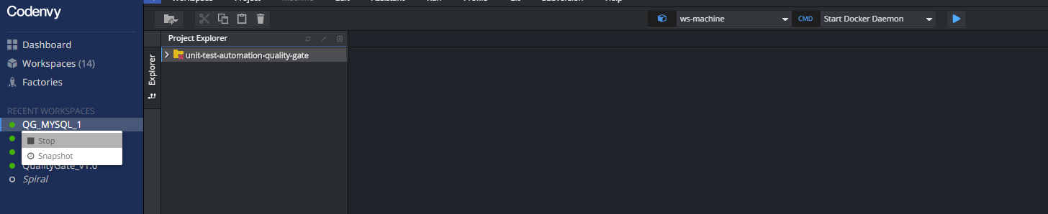
Cloning the code
Then Stop and Start the workspace. The code will be cloned. If it’s not cloned, stop/delete this workspace and create a new one following the link from slide 2.
So the workspace can contain project. You can import project from VCS, GitHub, ZIP. OR you can create files yourself.
Every project source files exist in two places: inside Codenvy server and inside workspace (container) (go ahead and do cd /projects to see it).
Workspace can have 2 states: running and stopped.
When you stop the workspace docker container is destroyed, everything you installed inside this container will be lost (if you didn’t create a snapshot for this), BUT everything you did inside your codebase will be safe as the next time you start the workspace Codenvy will inject to this workspace the project code from Codenvy server (Docker volumes make this happen).

Slide 8
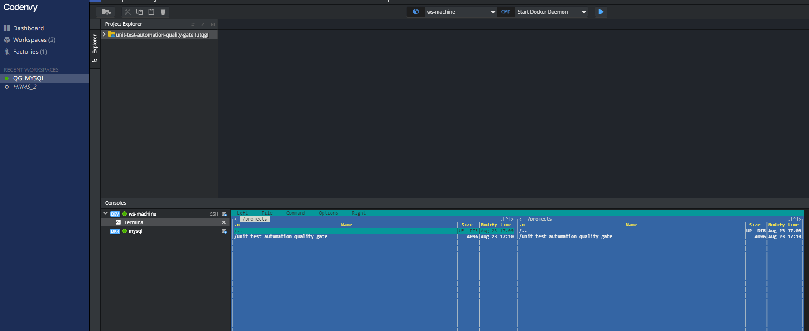
Interface
Okay, code has been checked out. Now we can see Codenvy GUI, We can see one sidebar on the left and the main screen area consisting of project tree, IDE editor, and JavaScript console (cool thing, by the way every prebuilt workspace have Midnight Commander, go ahead and enjoy it running mc)

Slide 9
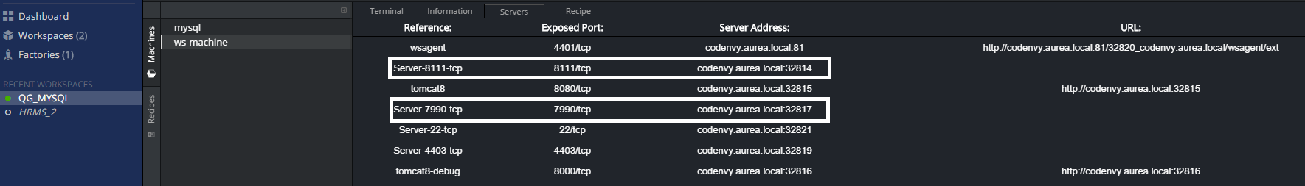
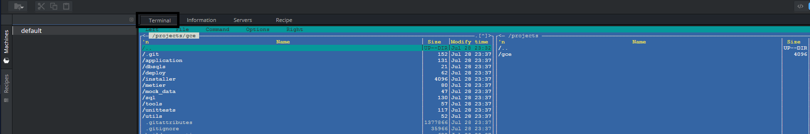
Workspace nuts and bolts...
To see a lot of interesting and IMPORTANT information about a workspace you have to switch to Operations perspective (see the icon on the top right corner). Here we can see 4 tabs: Terminal, Information, Servers, Recipe. Information tab contains machine name (well, workspace is a machine), ID, etc. On the screenshot i outlined the lines with addresses that we will need after we will built the product and start TeamCity and Stash services. Teamcity and Stash can be accessed on these links. NOTE: in your workspace the addresses will be different from the ones on the screenshot.
Terminal tab is a Java Script terminal to the machine (here I ran mc).

Slide 10
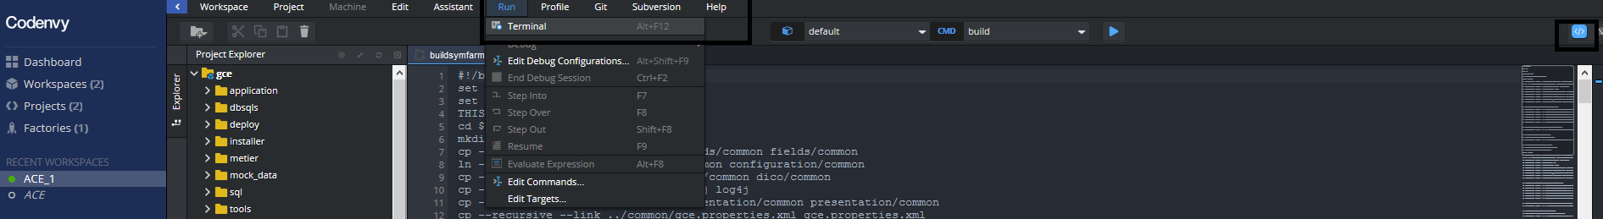
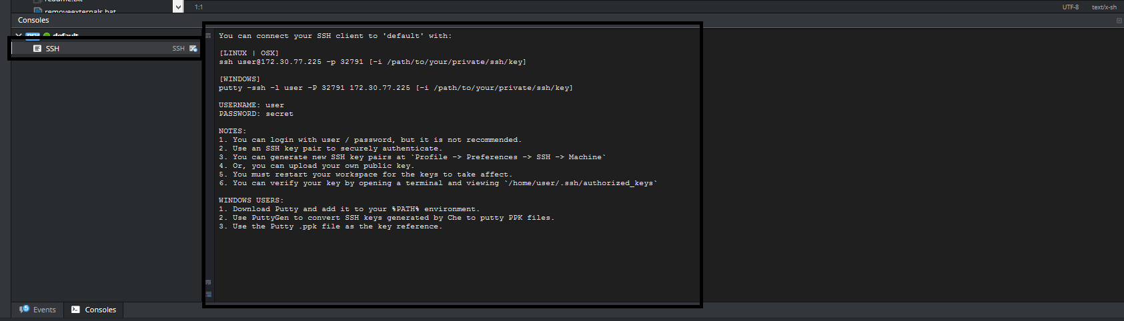
Terminal
Terminal is AWESOME. Let’s talk about it a bit more and i’ll show you some cool things.
Actually if you can’t see a terminal window on you Project Perspective just go to Terminal window and run it.
Or you can SSH to that container (that’s huge)... Just press on SSH to see the details.

Slide 11
Ports
Let’s switch back to Operations Perspective and investigate very important Servers tab.
Well, every workspace is built from image that as i already mentioned has some preinstalled services that allow to intercommunicate Codenvy server and workspace. These services has exposed ports that are randomly mapping to Codenvy server ports range 32768-65535.
This tab is important and useful tool when you are going to see the result of your build process.
On the screenshot below we can see the exposed 8111 port (TeamCity service) and 7990 port (Stash).
These ports are mapped to ports 32814 and 32817 ports on Codenvy server. So in order to access Teamcity we need to follow this link: http://codenvy.aurea.local:32814.
And in order to access Stash: http://codenvy.aurea.local:32817.
NOTE: in your workspace the addresses will be different from the ones on the screenshot.

Slide 12
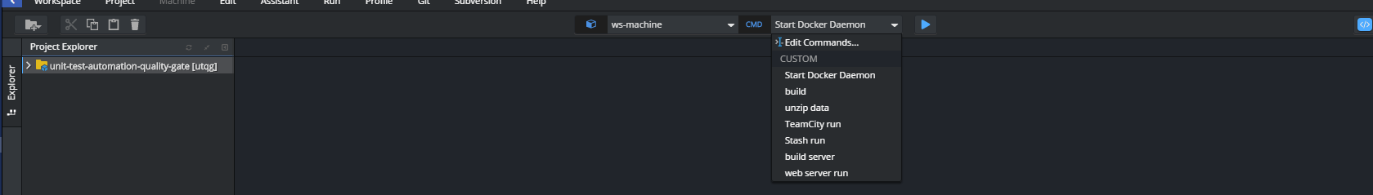
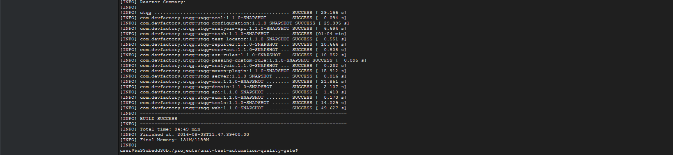
Commands.Building.
In order to make build and run process simple i injected commands in the workspace. Command can be run pressing on the Play button near it.
First let’s build the utqg-tool. Select ‘build’ command and press Play. Build successful.

Slide 13
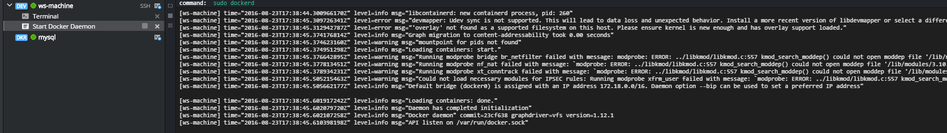
Commands.Building (continue).
Then we need to start docker daemon. Run ‘Start Docker Daemon’ command.
Then we need to start Teamcity server/agent. Run ‘unzip data’ command then run ‘TeamCity run’ command. This command will start Teamcity server and agent in separate docker containers. NOTE: it takes a while to start and run 2 Teamcity containers (around 5-10 minutes).
We can access Teamcity server using the link on Servers tab. Please look at slides #9, #11. We need a link with the exposed port 8111. Just paste it into your browser.

Slide 14
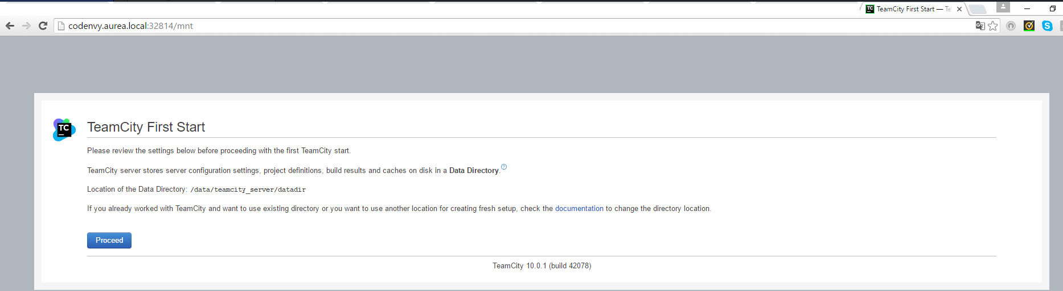
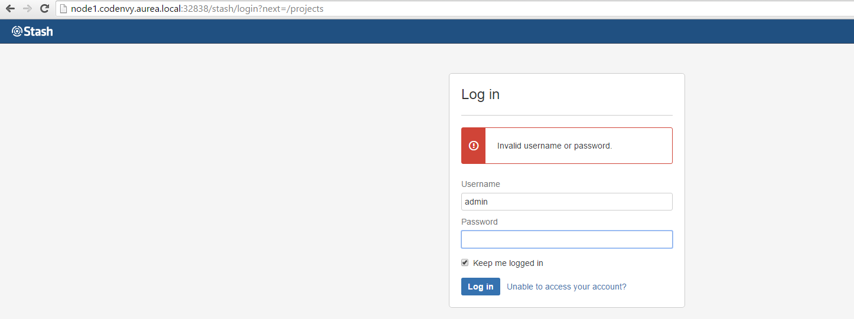
Commands.Building (continue).
To run Stash use ‘Stash run’ command. To access Stash in your browser please use the link from Servers tab, the one with exposed port 7990 (for reference please look at slides #9, #11).

Slide 15
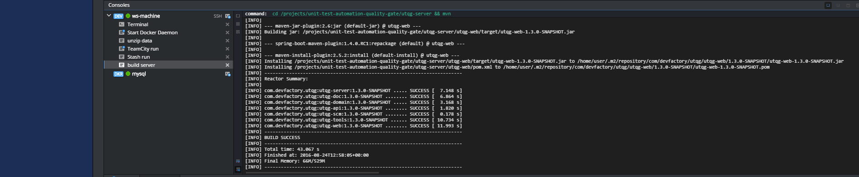
Commands.Building (continue). MySQL machine.
In order to build utqg-server run ‘build server’ command.
This workspace contains also separate MySQL machine (container) with the prebuilt database utqg and credentials root / <empty password>.
You can see MySQL machine on the Operations tab, Machines. It has an exposed standard MySQL port 3306, in order to know ip address of the machine run ifconfig command (look on the next slide). This info will help you to construct connection string from utqg-server to MySQL.

Slide 16
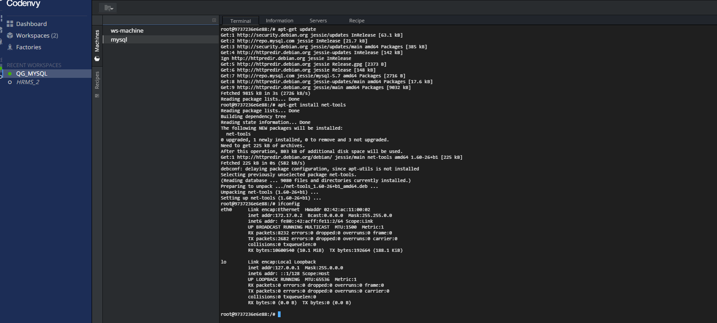
Commands.Building (continue). MySQL machine.

Slide 17
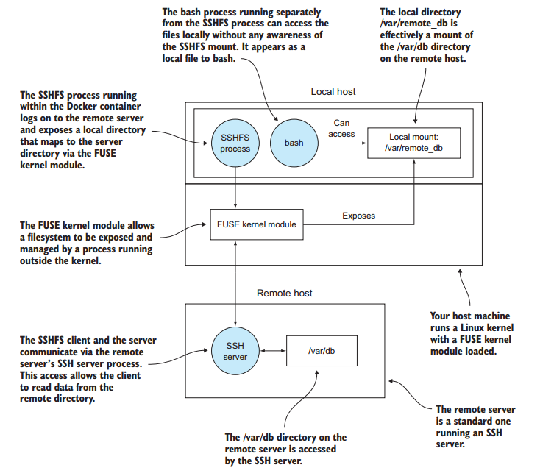
SSH to local IDE
To create SSH connection to your local IDE please follow the link:
http://codenvy.readme.io/v4.4/docs/using-desktop-ides
It’s really simple and working on every platform (Mac, Linux, Windows). It uses sshfs, so be informed that this solution doesn’t clone the contents from Codenvy server. It mounts it. So when you close sshfs connection the local folder where you’ve mounted your sources from Codenvy server will be empty. I showed the mechanics for those interested ================================>

